Slide 1
BPMS Live
BPMS for Informatica Migration
ProGear Id - GB_BPMS_LV-000888
Nov’2020
Savita Shekhawat (OHR: 703190688)

Slide 2

BPMS Live ► 7 Step Methodology
BPMS Live - The 7 Step Methodology
Building Process Framework
Customer VOC
Defining Project Charter
ARMI
Project Schedule/Plan
COPIS
Define
Operational Excellence Risk Assessment
Failure Mode and Effect Analysis
Finalizing (Input, Process, Output) Metrics
Finalizing Metrics Framework
Define Operational definitions of metrics
Client sign off on metrics framework
Set Up Measurement System
Data Collection Plan
Root Cause Analysis Calibration – Suggestions for Improvements
Analyze
Setting Up Reporting Structure
Governance Structure – Genpact and Lam Research
Structure of Report
Visual Management Standardization
Visual Management ( service now)
Closure
Continuous Improvement Roadmap
Control Plan
Way Forward
Standardization of Review Process

Slide 3
BPMS Live ► 7 Steps
Step Name | Objective | Acceptance Criteria | Tools
1. Building Process Framework | Business Case Process Criticality and Project Schedules | Holistic Business Case with clear framework outlined for the project Customer VOC to be shared | Customer VOC Project Charter, ARMI Project Schedule COPIS
2. Operational Excellence Risk Assessment | Operational FMEA | Incorporation of Operational FMEA | Operational FMEA model
3. Finalizing (input/process/output) Metrics | Identify Input-Process-Output measures | Finalizing Metrics Framework Define Operational definitions of metrics Client sign off on metrics framework | Matrices Framework Operational Definition Client Signoff
4. Set-up Measurement System | Create Data Collection Plan Perform Calibration | Set up Process for data collection Check for Operational and Calculation Definition of Metrics Rigor on Measurement System Analysis and Calibration | Data Collection Plan & Templates Calibration
5. Setting up Reporting Structure | Analysis of Metrics Governance Structure Reporting & Dashboard automation Implementation | Baselining and analysis of metrics Automating of reports & Dashboards Pilot Implementation Full scale implementation | Metrics Dashboard Implementation Plan
6. Visual Management Standardization | Visual Management to be implemented Organizing GEMBA Walk | Visual display of metrics on floor | VM Tools GEMBA
7. Continuous Improvement Roadmap | Create a line of sight for Transformational initiatives and changes | Identify Improvement opportunities CI roadmap Sign off and Closure | Transformation Road Maps Client Signoff
Corporate Panel Assessment – Mid Review for Initiation and Analyze
Corporate Panel Assessment – Final Review for Closure

Slide 4
Step 1
Build Process Framework

Slide 5

Voice Of Customer
What we heard from you …
Migrate ETL workflows that support Informatica v10
Informatica will be no longer providing support to version 9 and we need to migrate to V10. Look at current process and check where all we can improve and include that as well as a part of migration.
VOC: Anit Jain
VP : Morgan Stanley
Develop Integration Process
Notes:
Commodities and Global Markets

Slide 6

Customer Information
Customer Info | Particulars
Brief Customer Description | Morgan Stanley is a financial services corporation that, through its affiliates and subsidiaries, advises, and originates, trades, manages, and distributes capital for institutions, governments, and individuals. The company operates in three business segments: Institutional Securities, Wealth Management, and Investment Management.
Global customer delivery centers and Product lines | Investment Management provides asset management products and services in equity, fixed income, alternative investments, real estate investment, and private equity to institutional and retail clients through third-party retail distribution channels, intermediaries and Morgan Stanley's institutional distribution channel. Morgan Stanley's asset management activities were principally conducted under the Morgan Stanley and Van Kampen brands until 2009
Association with Genpact in terms of verticals and business | Morgan Stanley is our key customer in the BTS vertical since 2012
Customer Logo

Slide 7
BPMS Project Charter
Aladdin Analytics gets Portfolios, Benchmark and Position data from Blackrock in 5 packs for different regions daily as well as month end data. It uses Informatica PowerCenter to load this data into Analytics and to generate few extracts to downstream. These ETL Workflows are scheduled using Autosys. Since Informatica is no longer going to support version 9, there was a pressing need to migrate to version 10.2 by oct 2020
Business Case
Project Criticality
Precise and timely migration is the key to the success. Incorrect/ Inappropriate requirement handling may result in client dissatisfaction and we might lose an opportunity to get more business. With this in mind, we aimed to do smooth migration without impacting production load for a single day.
Key Project Deliverables
Smooth/clean migration was done by defined migration framework approach.
Process was enhanced by adding instance name in all the workflows which enabled easy triaging process
Generic utility was plugged in to purge older files & Standardization of few processes were also done.
In scope: Complete repository migration
Out of scope: Workflows which are no longer getting used
Boundaries
Project Team
Lead | Mentor | Champion
Savita Shekhawat | Sureshkumar Nemidoss | Yogesh Gambhir

Slide 8
Step 1: Building Process Framework
ARMI
Stakeholder | Role | Risk Assessment | Measurement System | Insights and improvement
Pankaj Garg | Sponsor | A | A | A
Yogesh Gambhir | Champion | A | A | A
Deepak Chopra | Quality Leader | A | A | A
Dheeraj Mathur | MBB | I | I | I
Sureshkumar Nemidoss | Black Belt | I | I | I
Savita Shekhawat | Project Owner | A | A | A
Savita Shekhawat | Project Team | M | M | M
A Approval of team Decisions e.g. Sponsor, Champion, MBB.
R Resource to the Team, one whose expertise skills may be needed on ad-hoc Basis
M Member of the team, with the authorities and boundaries of the Charter
I Interested party, one who will need to be informed

Slide 9
Project Schedule
Planned
In Progress
Completed
Apr’ 2020 | May’2020 | June’2020 | July’2020 | Aug’2020 | Sep’2020 | Oct’2020
Share business and technical requirements for Migration
Complete all the analysis
Complete the Infrastructure Build
Complete all the testing in lower level test env
Promote the build and code to Production
Go live – Checkouts are done
Phase |  | Planned Start Date | Planned End Date | Actual Start Date | Actual End Date
Define | Share business and technical requirements for Migration | 07-Apr-2020 | 28-Apr-2020 | 07-Apr-2020 | 28-Apr-2020
 | Complete all the analysis | 29-Apr-2020 | 28-May-2020 | 29-Apr-2020 | 28-May-2020
 | Complete the Infrastructure Build | 29-May-2020 | 15-July-2020 | 29-May-2020 | 15-July-2020
Review/Testing | Complete all the testing in lower level test environments | 16-July-2020 | 15-Aug-2020 | 16-July-2020 | 15-Aug-2020
 | Promote the build and code to Production environment | 16-Aug-2020 | 28-Sep-2020 | 16-Aug-2020 | 28-Sep-2020
Closure | Go Live | 29-Sep-2020 | 31-Oct-2020 | 29-Sep-2020 | 31-Oct-2020

Slide 10
Step 1: Building Process Framework
BPMS Communication Plan
Event | Responsibility | Message | Audience | Frequency | Date
Kick Off Meeting | Savita Shekhawat | Discussion on project Initiation | Savita Shekhawat, Yogesh Gambhir : GPM | One time | 07-Apr-20
Governance Call | Savita Shekhawat | Progress Updates | Head – Anit Jain VP, Savita Shekhawat Yogesh Gambhir: GPM – Genpact Informatica Admin Team | Monthly | May’20 Onwards
BB Status Meeting | Savita Shekhawat | Discussion on project progress | Sureshkumar Nemidoss Savita Shekhawat | Weekly | Ongoing
Phase Completion Review | Savita Shekhawat | Discussion on project Phase completion | Sureshkumar Nemidoss Somanathan Venkatesan | Phase Completion | Jun’20 Jul’20 Aug’20 Sep’20 Oct’20
Panel Review | Savita Shekhawat | Project review | Sureshkumar Nemidoss Somanathan Venkatesan | One time | Nov’20

Slide 11
Benefits from Project
The Potential benefits from the project delivered with the implementation of BPMS Live would be focused on:
Migration process helped to put the client in a supportive version of vendor product – Informatica
Included value added items such as ETLs with proper logging, ability to view past 4 days archived logs for triaging and parallel environments are added in QA for faster testing in the future

Slide 12
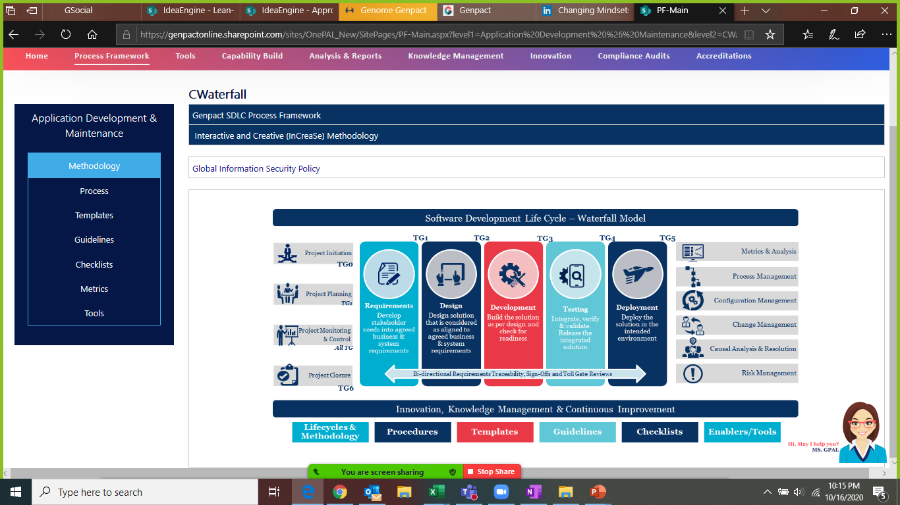
Document Process COPIS
Customer
Output
Process
Input
Supplier
V10 version of Informatica ETL workflows
V9 version of Informatica farm and ETL workflows
Informatica
Morgan Stanley

Slide 13
Step 2
Operational Excellence Risk Assessment

Slide 14
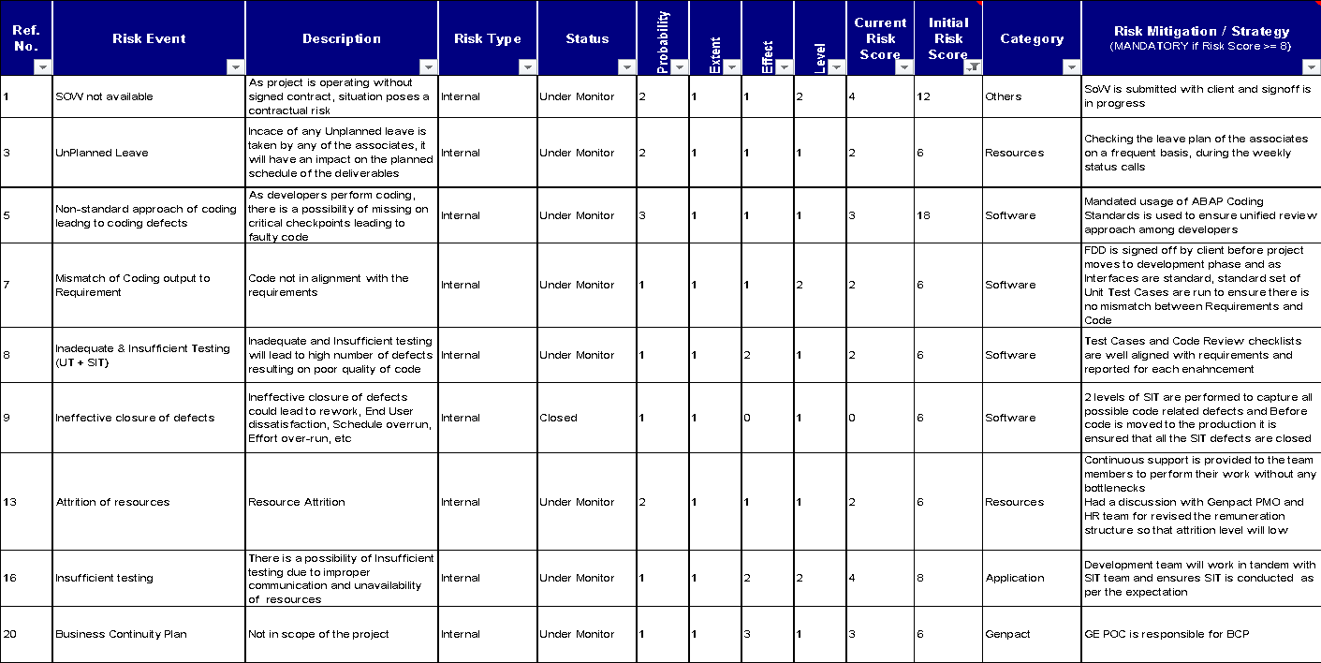
Risk Assessment – Failure Mode and Effect Analysis

Slide 15
Step 3
Finalizing (Input, Process, Output) Metrics

Slide 16
Finalizing (Input, Process, Output) Metrics
Input Measures
Process Measures
Output Measures
All Informatica servers with v9 along with its ETL workflows
Identify the servers that are in migration scope
Identify ETLs that are obsoleted which is excluded
Informatica server migration to v10
Repository changes that includes scripting modification, testing and migration
Value added items are included such as effective logging

Slide 17
Operational Definition for Metrics
S. No | Metric Name | Operational Definition
1 | Number of existing ETLs running in v9 | These ETLs are active running in 5 different regions at daily and monthly basis
2 | Number of obsolete ETLs | Many unused ETLs are still defined in v9 which needs to be excluded in the migration process
3 | Other projects workflow stored in our repository | There are several ETLs stored in our repo which requires script changes, testing during our migration
4 | Migration Defects | During the migration, several defects are raised in the lower level test environments

Slide 18
Step 4
Set Up Measurement System

Slide 19
Data Collection Plan
Measure Name | Description
What | Total no of defects recorded during the migration
When | June 2020 – Oct 2020
Where | Excel .CSV file
How | Downloaded the tickets created data from Service-Now ticketing tool
Who | Savita Shekhawat
Sample Size | 100% of tickets

Slide 20
Root Cause Analysis Calibration – Suggestions for Improvements
Suggested Enhancements:
While testing in DEV few suggestions came up for improvement and later all of below were accommodated in the migration scope
1. Most of the ETL workflows run for 5 different region daily and monthly. Changes are done to run with instance name to make triaging easier.
2. Different XML files are used as source thus we introduced pre-processing logic and it was included in main process.
3. In few workflows unnecessary logs were getting generated. Our migrated ETLs were modified to have proper logging mechanism.
4. Due to standard setting, older logs couldn’t be seen in workflow monitor. Our Idea of running with instance name enabled us to see at least 4 days older logs now
Suggested RCA Categories and RCA Components
RCA Category | RCA Component
Code Issue | Project Configuration; Roles and Permission; Integrations - Application;
Requirement Gap | Artefacts Mismatch; Functional Understanding; Document Mismatch
Product Issue | Product Documentation; Product Configuration;
RCA Category | RCA Component
Data | Input Test Data
Environment | Upgrades; Connectivity
Performance Issue | Product Configuration; Product Customization;
Understanding Gap | Incorrect Execution; Requirement Understanding

Slide 21
Step 5
Setting Up Reporting Structure

Slide 22

Governance Structure – Genpact and Morgan Stanley
Yogesh Gambhir
Assistant Vice President, Operations
Savita Shekhawat
Project Leader
Monthly Management Review
(Monthly)
Review progress against agreed priorities
Data Analysis for current releases
Review operational performance and Dashboard
Genpact will work with MS team to drive best practices/benchmarking
Level 2
(BI-Monthly)
LDT Team
Ops Team
Weekly Service Delivery
Data collection for recent releases
Review operational performance and Dashboard
Highlighting issues / concerns
Project Progress Updates
Venkatesan Somanathan
Project Leader
Sureshkumar Nemidoss
Project Team
Savita Shekhawat
Level 1

Slide 23
Step 6
Visual Management Standardization

Slide 24
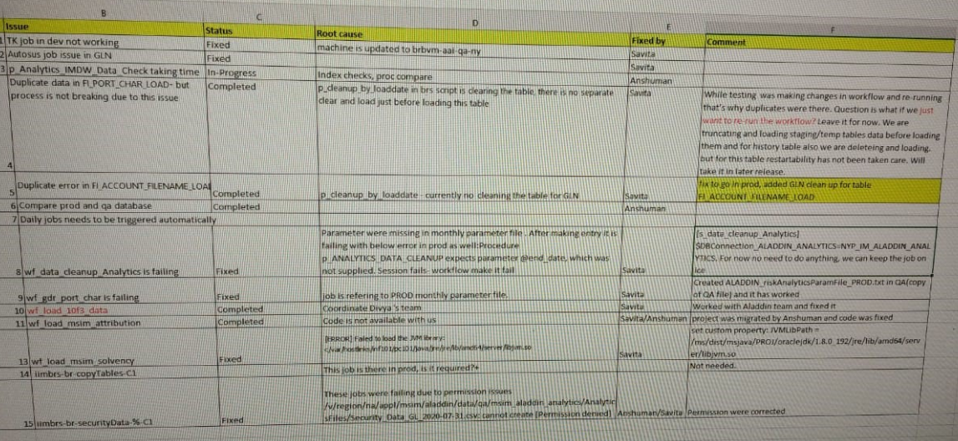
Structure of Defect Report
Filters Used in the Report

Slide 25
Step 7
Continuous Improvement Roadmap

Slide 26
Control Plan
 | Work Plan | Checking the work done |  | Action to be Taken | Responsibility
S.No. | Activity | Output Measure | Frequency | Action to be taken | Responsibility
1 | Monthly / Quarterly Audits | No of tickets created | Monthly / Quarterly | Reporting to the Client | Savita Shekhawat
2 | Configurations (Add/ Modify/ Delete) | Change Management Request, Operational Requirements | Need Basis | Development / Testing / Implementation Required | Savita Shekhawat
3 | Access to Reports | Access to be granted to the requesters | Need basis | To provide access of the reports which depicts the no of service requests. | Savita Shekhawat

Slide 27
Way Forward
As a Way Forward following enhancements can be looked upon by Morgan Stanley team :
PoV / PoC for FOSS based ETL tools

Slide 28
Standardization of Review Process
Business Case:
Informatica is a proprietary software that force customers to migrate when there’s a new version out there. In order to avoid this situation, we need to come up with attractive FOSS alternatives. Kafka and Clover ETL are the proven tools in the data integration industry… however we need to do quick PoC in the client environment to make sure the existing ETL workflows can be seamlessly migrated to these new tools.
Proposed Solution :
Apache Kafka
Clover ETL
  Potential Impact
  Effort Saving – As this is a Free and Open source tools, we save lots of man hours on unnecessary migrations.

Slide 29
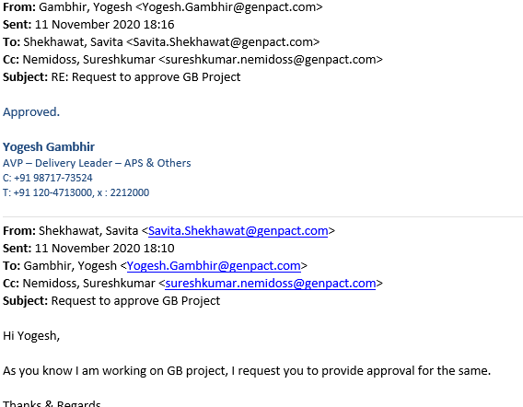
Project Approvals
Champion Approval Email

Slide 30
Thank You

